Slide 1

Airport Hacks using Kali NetHunter

Slide 2
About me
Lead Consultant at Infosys
Information Security Enthusiast
OSCP and CISSP certified.
Prash.siv@gmail.com
Twitter: @prashsiv

Slide 3
What is it?
Android ROM overlay
  Custom kernel
  A Kali Linux chroot
  Accompanying Android application
Features
  802.11 Wireless Injection
  USB HID Keyboard attacks
  Supports BadUSB MITM attacks.
  full Kali Linux toolset
  USB Y-cable support
  Software Defined Radio support

Slide 4
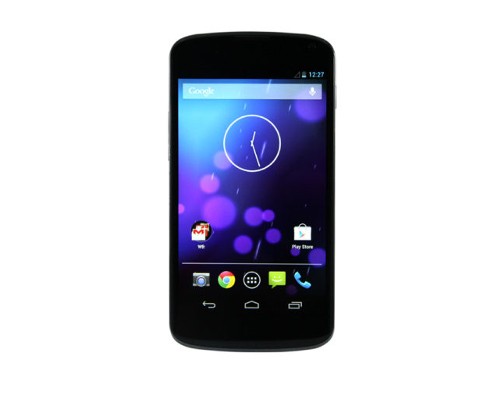
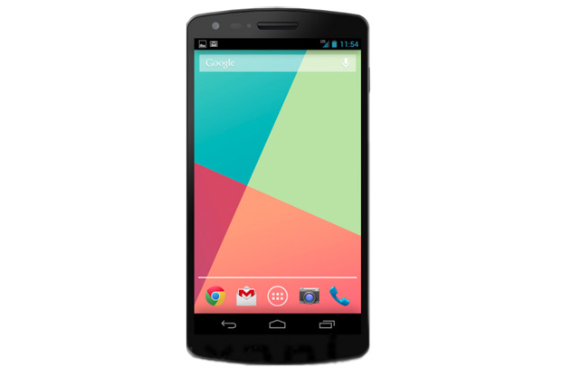
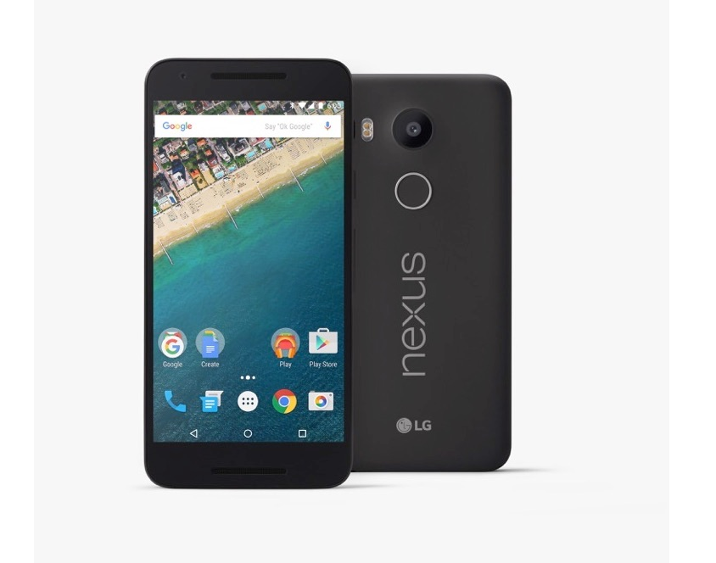
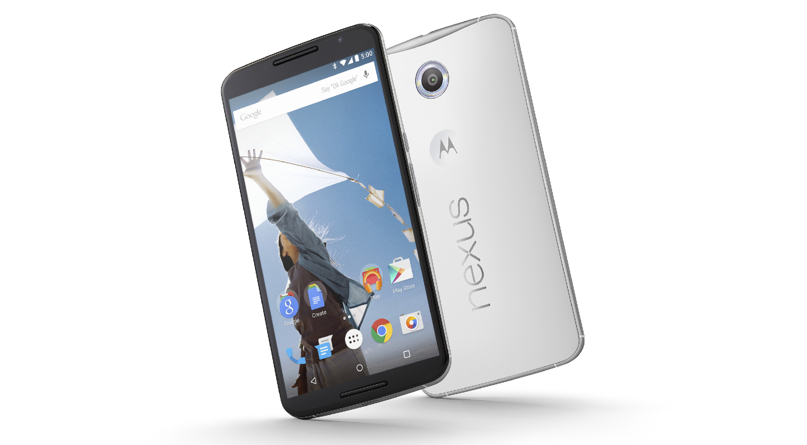






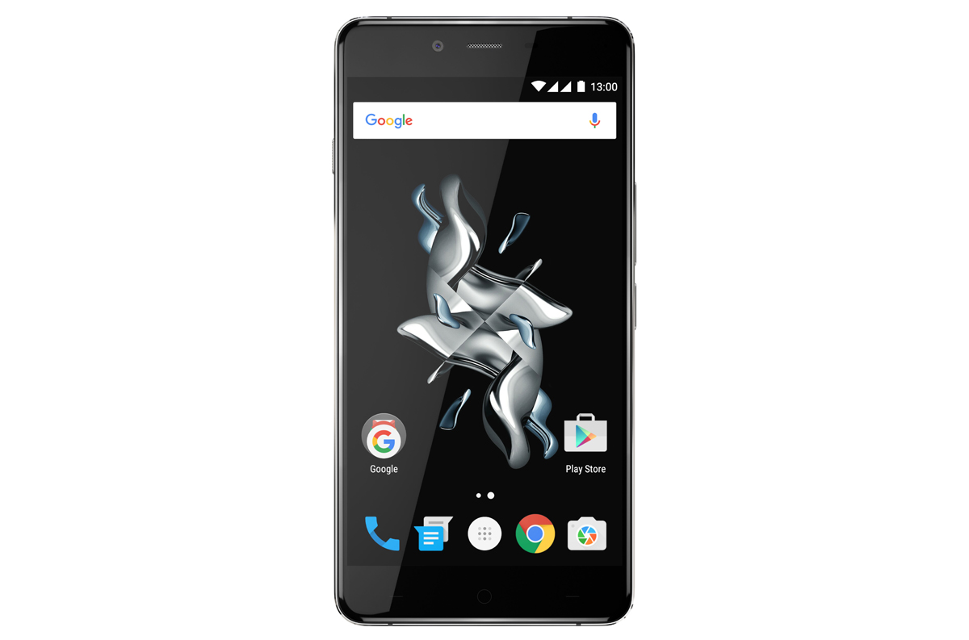

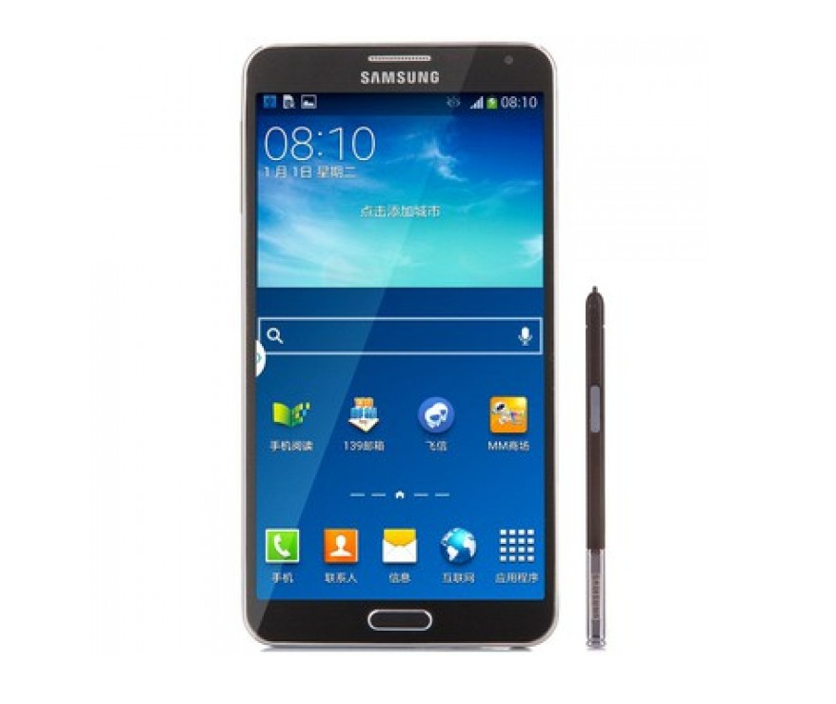
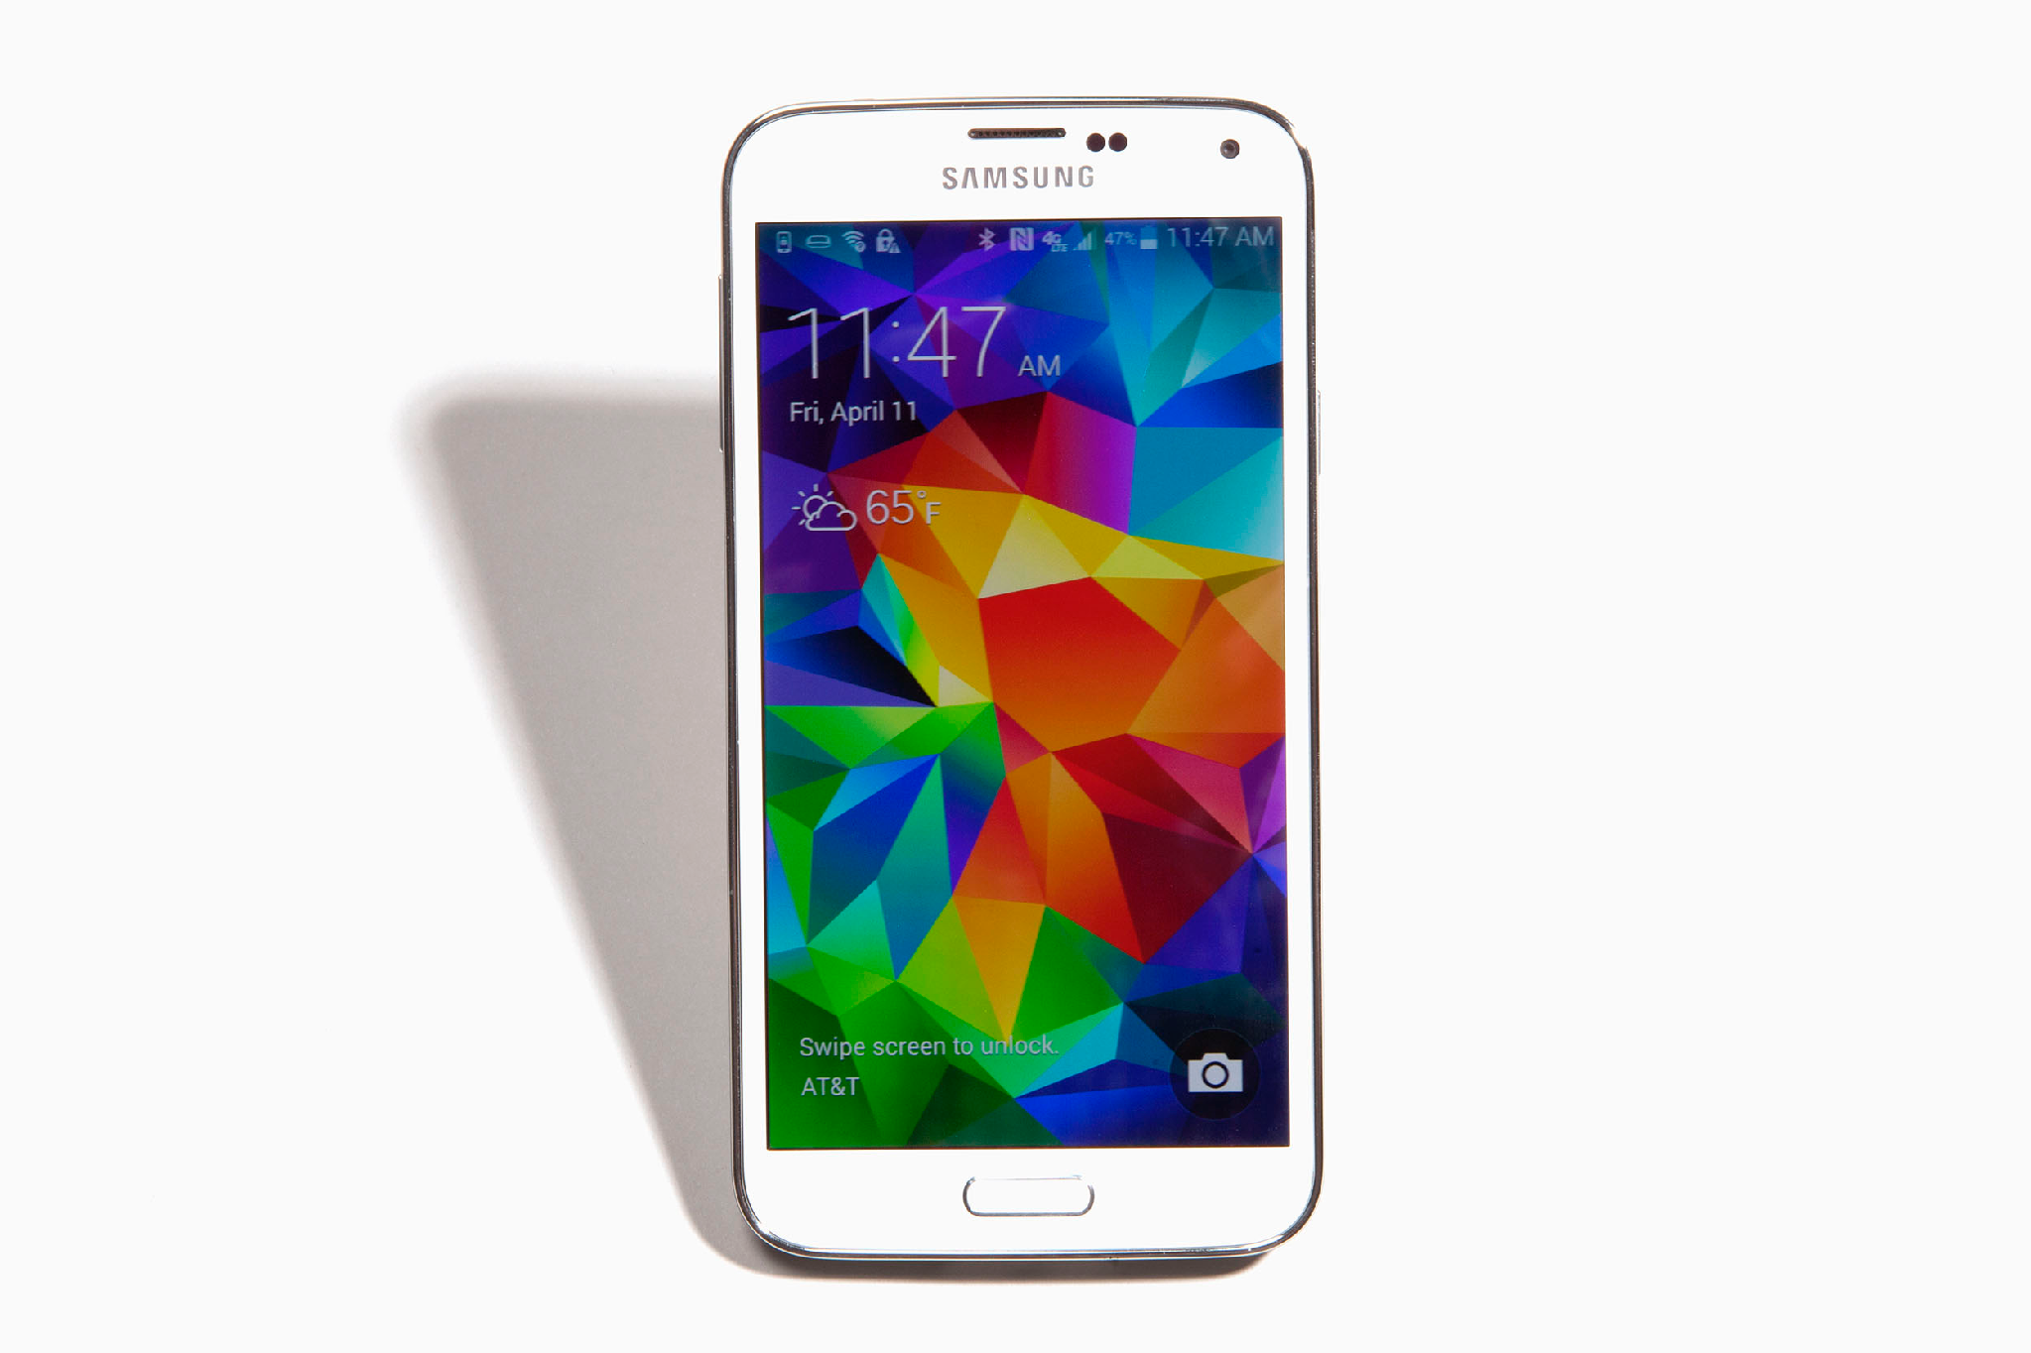
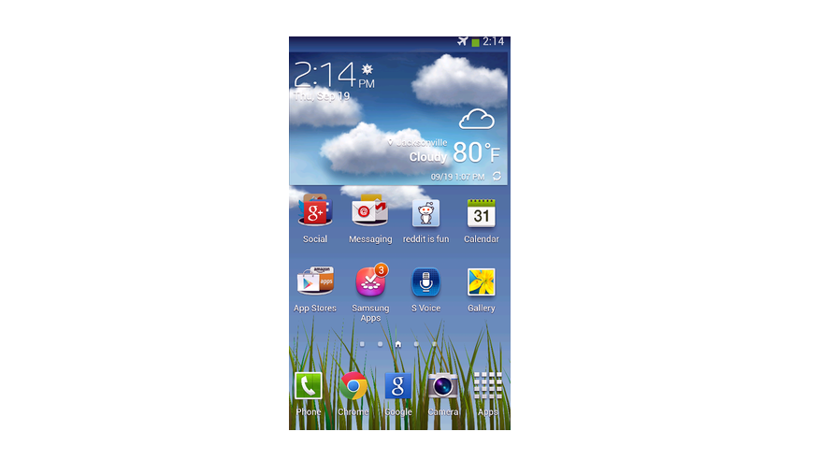



Current OOB Support
Nexus 4
Nexus 5
Nexus 5x
Nexus 6
Nexus 6P
Nexus 7
Nexus 9
Nexus 10
OnePlus One
OnePlus Two
OnePlus X
LG G5
Galaxy Note 3
Galaxy S5
TouchWiz
SHIELD tablet
SHIELD tablet K1
CM 13.0

Slide 5

Installation
Root
Install custom recovery
Unlock Boot loader

Slide 6
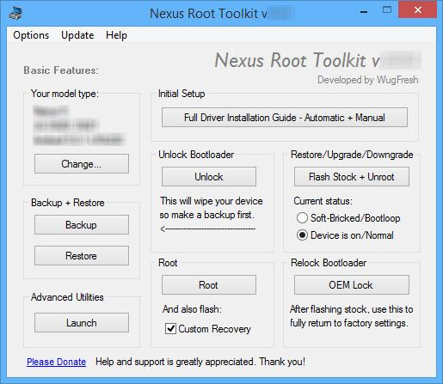
Installation
Wugfresh Nexus Root toolkit
https://github.com/offensive-security/kali-nethunter/wiki/Windows-install

Slide 7
On-the-go Arsenal
Kali Chroot | MITM Framework | cSploit
MAC Changer | NMap Scan | Wi-Fi Attacks
VNC Manager | Metasploit Payload Generator | Shodan
HID Attacks | Searchsploit | MANA Wireless Toolkit
DuckHunter HID | NetHunter Terminal Application | DriveDroid
BadUSB MITM Attack

Slide 8
On-the-go Arsenal
Kali Chroot | MITM Framework | cSploit
MAC Changer | NMap Scan | Wi-Fi Attacks
VNC Manager | Metasploit Payload Generator | Shodan
HID Attacks | Searchsploit | MANA Wireless Toolkit
DuckHunter HID | NetHunter Terminal Application | DriveDroid
BadUSB MITM Attack

Slide 9

HID attacks
Powersploit
Windows CMD
DuckHunter HID

Slide 10
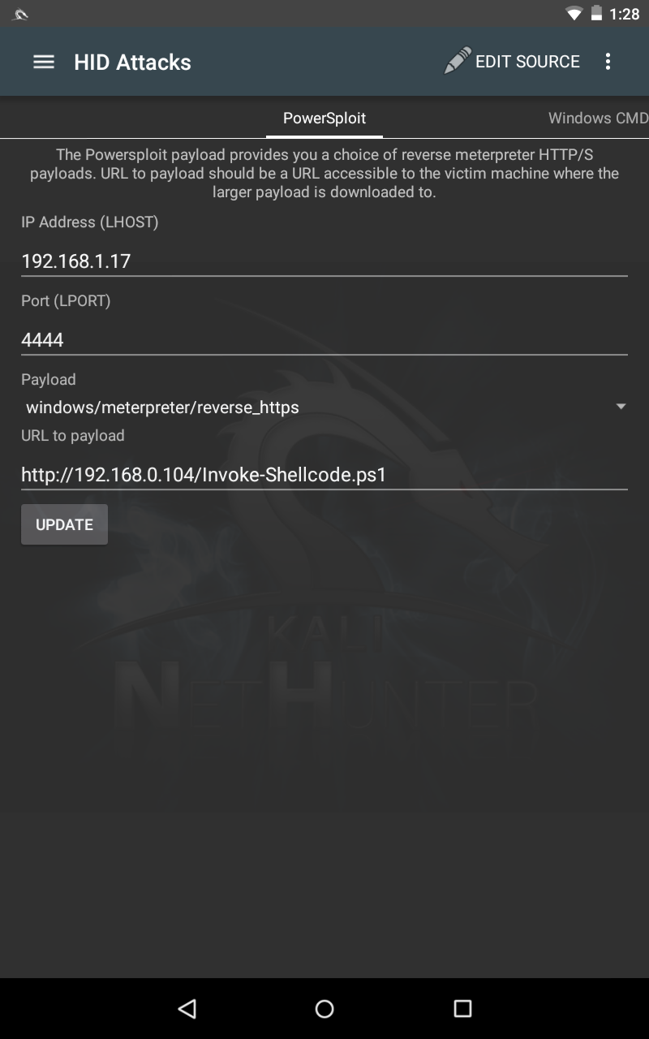
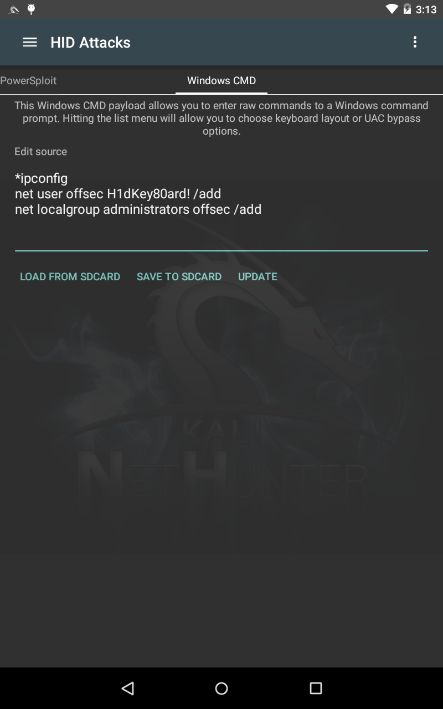
Power sploit
Point to the Powershell Script
HID types the powershell code in notepad, saves and executes as high priv user.
Ref:
  https://github.com/PowerShellMafia/PowerSploit
  https://github.com/adaptivethreat/Empire/tree/master/data/module_source
WindowsCMD
Opens command prompt and executes commands. (That simple)

Slide 11


Duck Hunter
Translates Ducky scripts to HID script
Generate Ducky Script
  https://ducktoolkit.com
Advantage:
Faster than HID powersploit attack.
Community contribution
Disadvantage:
Few unsupported Duckyscript commands.
No Debugger
https://github.com/byt3bl33d3r/duckhunter
https://github.com/hak5darren/USB-Rubber-Ducky/wiki/Duckyscript

Slide 12
What does this Ducky script do?
ALT SPACE
DELAY 1000
ESC
DELAY 5000
ALT SPACE
DELAY 1000
ESC
DELAY 5000
ALT SPACE
DELAY 1000
ESC
DELAY 5000
……….

Slide 13
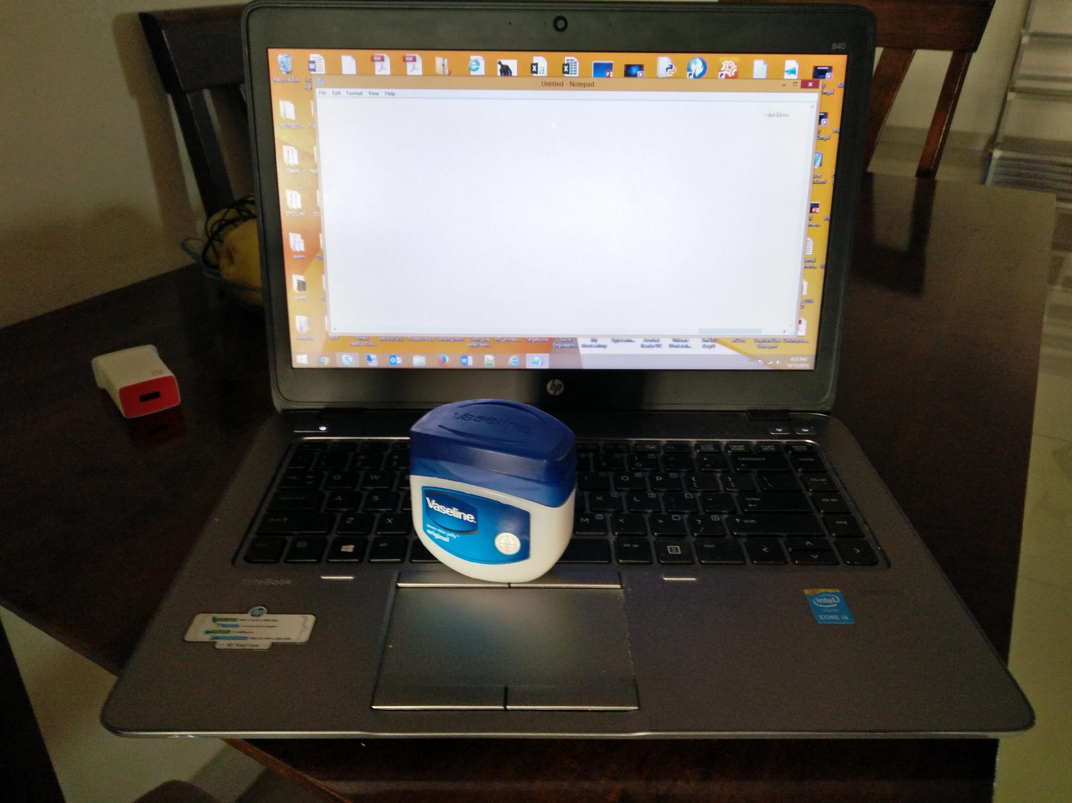
An Alternative?

Slide 14
Wifite
Automated Aircrack-ng
Point and shoot

Slide 15

Mana Evil Access Point
Authors:
  Dominic White & Ian de Villiers
  https://github.com/sensepost/mana
Listens and spoofs preferred network list beacons
Mana
SSL Split
Hostapd
SSLStrip+
iptables

Slide 16
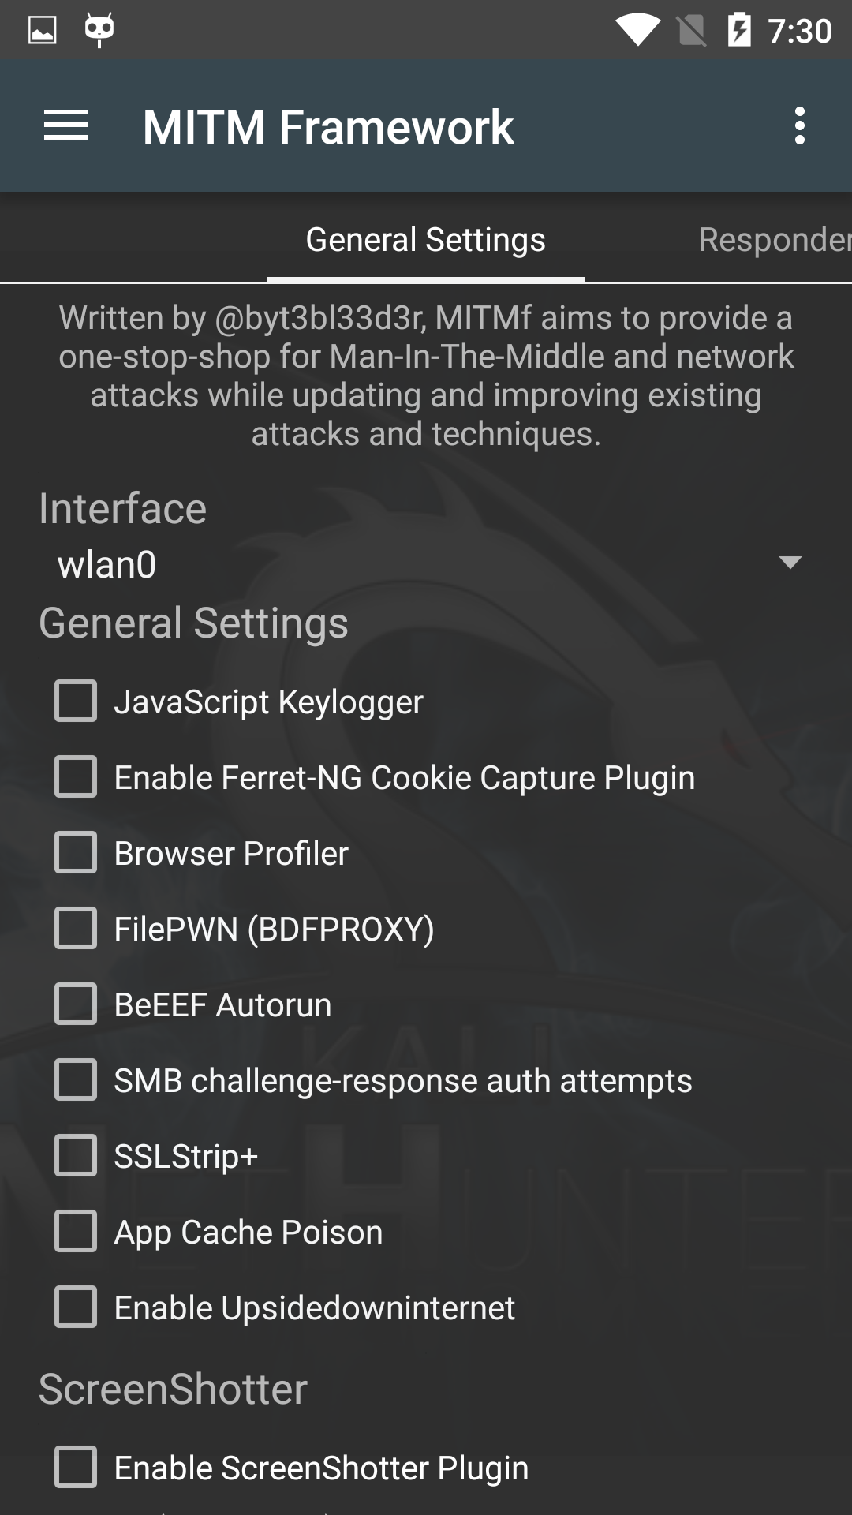
MITM Framework
Man in the middle framework
Author: @byt3bl33d3r
  https://github.com/byt3bl33d3r/MITMf
keylogging, cookie capture, ARP poisoning, injection, spoofing, and much, much more.
Demo speaks it all.

Slide 17

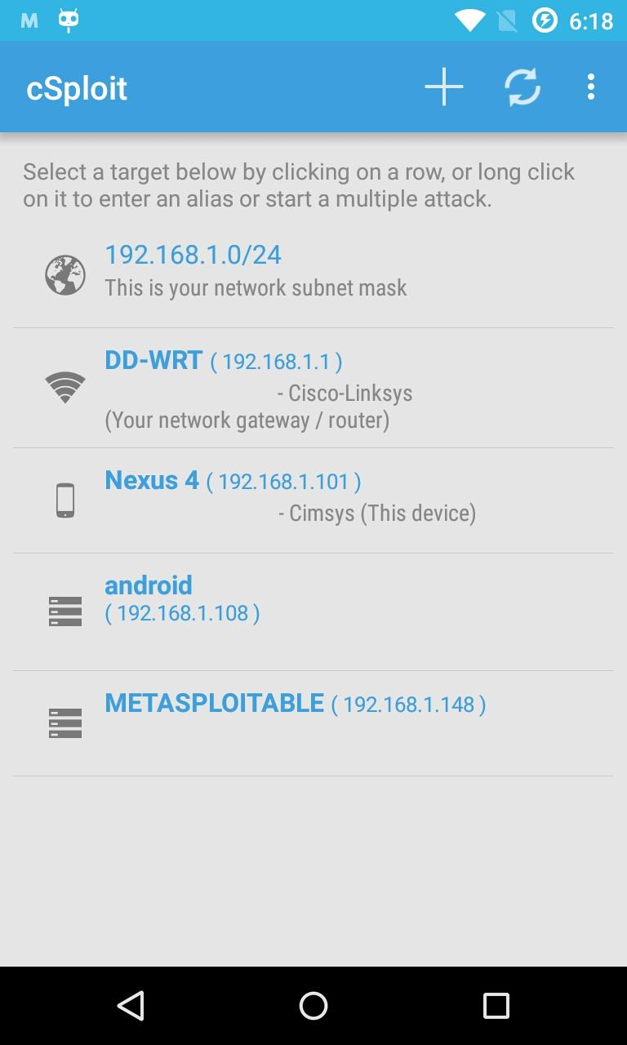
Csploit
http://www.csploit.org/
Author: @tux_mind
The most complete and advanced IT security professional toolkit on Android (That’s what they say)
Fingerprint, exploit, MITM, and all that.
Younger brother of Armitage

Slide 18
BadUSB MITM
This didn’t work for me. So no demo….just talk ☺

Slide 19
Questions?
@prashsiv
prash.siv@gmail.com

